Slide 1

ROOMPULSE AI
v1.0 • Client-Side rPPG Engine
THE INVISIBLE HEALTH GUARDIAN
Contactless Vital Sign Monitoring via Standard Webcams
Transforming ordinary optical sensors into non-invasive physiological monitors without wearables, physical contact, or cloud streaming.
PROJECT CREATOR
LIVE DEMO APP
Hossam Elshahaby
roompulseai.lovable.app

Slide 2



THE CHALLENGE
Friction & Hardware Limitations in Vital Monitoring
Wearable Friction & Cost
Telemedicine Blind Spots
Cloud Privacy Risks
Smartwatches and chest straps are expensive, require constant battery charging, and suffer high patient drop-off.
Virtual clinical visits lack objective baseline physical metrics because patients lack clinical-grade hardware at home.
Streaming continuous facial video to external cloud servers creates severe HIPAA/GDPR regulatory and privacy concerns.
High adoption barrier
Diagnostic uncertainty
Data security liability
Traditional pulse oximeters require physical attachment — RoomPulse AI eliminates hardware dependence entirely.

Slide 3
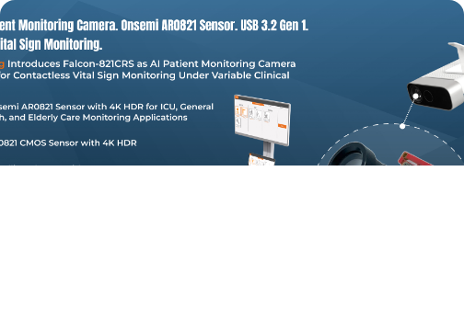
THE SOLUTION
RoomPulse AI: Core Platform Features
Triple-ROI Tracking
Isolates forehead and both cheek regions to track sub-visual dermal micro-colors.
Multi-Algorithm Switching
Toggle seamlessly between POS, CHROM, and GREEN rPPG signal processors.
Dynamic Trust Score
Evaluates lighting and motion quality; rejects static photo spoofs automatically.
Validation Lab Mode
Compare real-time webcam telemetry against benchmark reference datasets.
Live BVP Signal Stream

Slide 4
REAL-WORLD IMPACT
Transforming Care, Triage, and Privacy
100%
$0
< 2.4
On-Device Privacy
Hardware Overhead
BPM Variance
Video frames never leave the local browser. Zero server transmission eliminates data breach risks.
Leverages existing laptop or smartphone webcams. Demotes costly wearables from a requirement to an option.
Clinical-grade accuracy using POS plane-orthogonal algorithms validated against ground-truth reference sensors.
ZERO-TRUST PRIVACY
UNIVERSAL ACCESS
VALIDATED PRECISION
Target Environments: Remote patient monitoring, virtual clinic triage, elder care safety, worker stress analysis, and touchless fitness check-ins.

Slide 5
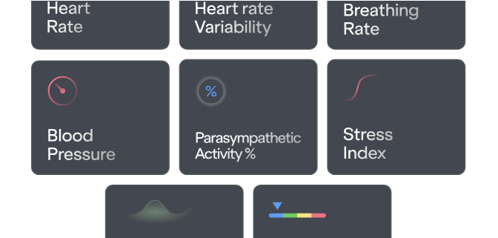

WALKTHROUGH
Watch Video Demo
Live Platform Demonstration
STEP 1: ROI LOCK
Forehead & dual cheek mesh alignment with dynamic motion compensation.
STEP 2: TRUST EVALUATION
Automatic motion/lighting diagnostic prevents false readings on still photos.
STEP 3: REAL-TIME BVP
Live switching between POS, CHROM, and GREEN channel pulse extraction.
Video Transcript Reference: "Everything runs on the device. Your video never leaves your computer."

Slide 6


Thank You & Questions
RoomPulse AI — Advancing accessible, private, and contactless vital sign intelligence.
AUTHOR
LIVE WEB APP
VIDEO DEMO
Hossam Elshahaby
roompulseai.lovable.app
youtu.be/hrY0d0BEmIc

Slide 7


Image Sources
https://cdn.nwe.io/files/x/ec/f9/94961ab94a37f69d8a540e306bae.jpg
Source: www.newswire.com
https://cdn.prod.website-files.com/680280c18df8e68403545b30/681c98e8c7f4d6d2191ddb57_Vital%20signs%20-%20mobile.svg
Source: shen.ai

